Slide 1

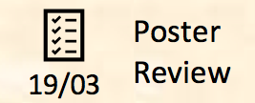



Iteration 3
Iteration 4
Iteration 7
Iteration 8
Iteration 11
Iteration 12
20/10 – 09/11
10/11 – 23/11
22/12 – 04/01
05/01 – 18/01
16/02 – 01/03
02/03 – 15/03
- Accounts Module
- Homepage Module
- Track Search Module
- Skills gap analysis
- Usability Testing
- UAT 1
- Track Search Module
- SOLR search engine
- Post UAT 1 debugging
- Career Search Module
- SOLR search engine
- Wage analytics
- Post UAT 2 debugging
- Analytics Module
- Analytics Module
- Dashboard Module
- Improve UI
Final Exams
Mid-Terms
SEPT 2018
OCT 2018
NOV 2018
DEC 2018
JAN 2019
FEB 2019
MAR 2019
APR 2019
Iteration 1
Iteration 2
Iteration 5
Iteration 6
Iteration 9
Iteration 10
Iteration 13
22/09 – 05/10
06/10 – 19/10
24/11 – 07/12
08/12 – 21/12
19/01 – 01/02
02/02 – 15/02
16/03 – 29/03
- Creation of Wiki
- Database Design &
Implementation
- High fidelity prototype
- Administrative Module
- Career Search Module
- SOLR search engine
- UAT 2
- Analytics Module
- Deployment
- Dashboard Module
- Improve UI
- Final Debugging and Testing for Finals
- Gather Sponsor
Requirements
- Proposal Preparation

Slide 2
Iteration 2
Iteration 3
Iteration 6
Iteration 7
Iteration 10
Iteration 11
20/10 – 09/11
10/11 – 23/11
22/12 – 04/01
05/01 – 18/01
16/02 – 01/03
02/03 – 15/03
- Accounts Module
- Homepage Module
- Track Search Module
- Skills gap analysis
- Usability Testing
- UAT 1
- Track Search Module
- SOLR search engine
- Post UAT 1 debugging
- Career Search Module
- SOLR search engine
- Wage analytics
- Post UAT 2 debugging
- Analytics Module
- Analytics Module
- Dashboard Module
- Improve UI
Final Exams
Mid-Terms
SEPT 2018
OCT 2018
NOV 2018
DEC 2018
JAN 2019
FEB 2019
MAR 2019
APR 2019
Iteration 1
Iteration 2
Iteration 4
Iteration 5
Iteration 8
Iteration 9
Iteration 12
22/09 – 05/10
06/10 – 19/10
24/11 – 07/12
08/12 – 21/12
19/01 – 01/02
02/02 – 15/02
16/03 – 29/03
- Creation of Wiki
- Database Design &
Implementation
- High fidelity prototype
- Administrative Module
- Career Search Module
- SOLR search engine
- UAT 2
- Analytics Module
- Deployment
- Dashboard Module
- Improve UI
- Final Debugging and Testing for Finals
- Gather Sponsor
Requirements
- Proposal Preparation

Slide 3


IS480
2018-2019 T2

Slide 4




CURRENT
ITERATION
UPCOMING
MEETINGS
CURRENT
MILESTONE
TEAM
MEETING
6 Nov
2
7 Nov
SPONSOR MEETING
OUT OF 13 ITERATIONS
20 OCT - 09 NOV
ACCEPTANCE
09 NOV
SUPERVISOR MEETING
-

Slide 5
OUR PROJECT
Track2Career
A Track & Career Discovery Platform
Spearheaded by SMU’s very own School of Information Systems (SIS), Track2Career will be a tool that empowers undergraduates to make better informed decisions in career-planning.
The platform enables students to acquire valuable insights on the opportunities available for each academic track specialization. Students may also specify a dream career, and the application will offer structured guidance by charting a pathway towards developing the skillset necessary to achieve their desired career.
Additionally, Track2Career comes complete with wage analytics tools to offer even greater clarity in the career-planning process.

Slide 6

MILESTONES
PROPOSAL
23 OCT 2018
ACCEPTANCE
09 NOV
MID-TERM
04 FEB – 15 FEB
POSTER
19 MAR
FINALS
8 – 16 APR

Slide 7

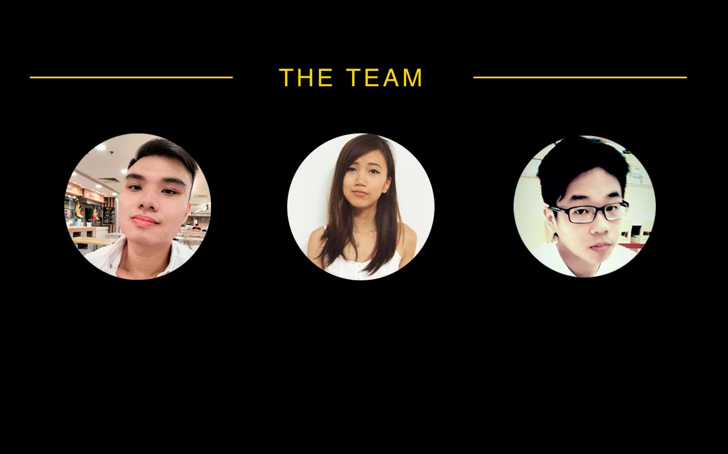
THE TEAM
JIN LIM
ASHLEY TAN
TAN ZER DONG
PROJECT MANAGER
QUALITY ASSURANCE
FRONT-END DEVELOPER
ASSISTANT PROJECT MANAGER
BACK-END LEAD
In charge of back-end development.
Maintains database logic and server administration. Handles smooth integration of back-end and front-end.
Directly assists project manager.
Oversees project development and facilitates meetings. Liaises with key stakeholders. Management of risks. Ensures key milestones are delivered. Keeps track of documentations, metrics and team wiki page.
Develops and schedules test cases.
Heads the execution of User Testing and the evaluation of test results.
Keeps track of bug log and bug metrics.
Assist the front-end development.

Slide 8
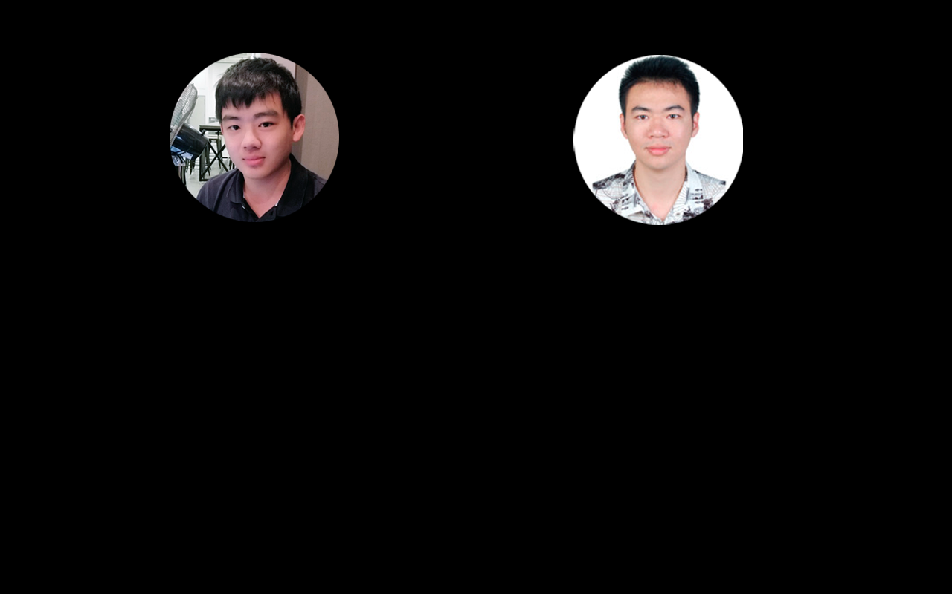
REGAN SEAH
XU HAONAN
FRONT-END LEAD
BACK-END DEVELOPER
In charge of back-end development. Design technical solutions.
Handles back-end logic and frameworks. Assist in the smooth integration of
back-end and web application.
In charge of front-end development.
Design overall User Interface of web application. Ensure usability of User Interfaces & gather feedback from users.

Slide 9

Track2Career
Track2Career will be a web-based and mobile friendly application that assists undergraduates and potential students entering from post-secondary institutions in their career-planning. This application will enable students to explore their current/desired academic tracks for opportunities, courses and skills which will ultimately lead them towards their dream job.
Beyond the search utilities, the system further simplifies the process through the suite of valuable insight tools encompassing a dashboard summary, skills analytics, and wage analytics.

Slide 10
MOTIVATION
Track2Career is spearheaded by SMU’s very own School of Information Systems (SIS).
SIS understands that career-planning is a daunting task to young adults and working professionals alike. The development of Track2Career will equip users with a powerful tool that demystifies and simplifies the career-planning process.

Slide 11
FUNCTIONS
CORE
FUNCTIONS
SECONDARY
FUNCTIONS
TRACK DISCOVERY MODULE
Perform search with predictive and suggestive dropdown list
Highlight track-specific skills by weightage
CAREER DISCOVERY MODULE
Perform search with predictive and suggestive dropdown list
Highlight job-specific skills by weightage
ANALYTICS MODULE
Perform comparison between user’s skill profile and requisite skillset for dream job
Retrieve information from the API of JobSense and display relevant jobs, industries and career pathway
Retrieve information from the API of Wage Dashboard and display wage analysis
ACCOUNTS MODULE
User Login / Logout
Collects user profile information such as skills and courses taken
DASHBOARD MODULE
Provide summary of user’s skill profile, dream job and ideal track
Keep record of previous search summaries
ADMININSTRATIVE MODULE
Uploading of CSV file to update track, course and skills details

Slide 12

SPONSORS
CELINA KOH
CAREER STRATEGIST
SINGAPORE MANAGEMENT UNIVERSITY
SCHOOL OF INFORMATION SYSTEMS
Celina excels in career guidance and has great working experience in Job and Career Development from LASALLE and Employment & Employability Institute(e2i). She is currently providing guidance as a career strategist at SMU and seeks to enhance student’s career development abilities.
WENDY TAN
SENIOR INSTRUCTOR
SINGAPORE MANAGEMENT UNIVERSITY
SCHOOL OF INFORMATION SYSTEMS
Wendy has vast experience across Career Development, Teaching & Learning, Financial Management and Engineering. She provides her guidance and expertise in managing skills-career project development (JobSense) with Living Analytics Research Centre (LARC).

Slide 13
Track2Career streamlines the career-planning process
Forging a career is an important milestone in life and career-planning is a fittingly extensive task. Most career guides’ outlines take anywhere from 90 minutes to several weeks to complete (Todd, 2017)
It’s not a one-time procedure either, Forbes estimates that the average professional changes careers 5 to 7 times in their lifetime, and recommends that career plans be reevaluated every 6 to 12 months (Forbes, 2018)
Track2Career generates a robust and intuitive career plan within 3 minutes and is easily revised and customized to a user’s progression and changing needs.
Career planning is an important task, but it needn’t be a difficult one.
Sources: https://www.forbes.com/sites/ashleystahl/2018/08/29/3-steps-to-develop-your-career-plan/#1e3282d74910,
https://80000hours.org/career-guide/career-planning/

Slide 14
X-Factor
Manual Process | Time (minutes) | Track2Career | Time (minutes)
Manually evaluating one’s skillset and proficiencies | 20 | Skillset is automatically populated from user profile and courses taken | 2
Charting out the courses and associated skills developed by each of the 6 academic tracks | 5 x 6 = 30 | Search function retrieves all courses and the potential skillset of every course | 0.08 min (5 seconds)
Identifying skillset needed for desired job | 10 | Job-search function retrieves requisite skillset | 0.08 min (5 seconds)
Analysing skill gap between self and desired job | 10 | Skill-gap analysis is automatically generated | 0.08 min (5 seconds)
Analysing wage prospects | 10 | Wage analysis tool | 0.08 min (5 seconds)
Building a structured plan to bridge skill-gap to desired job | 15 | Structured career pathway is automatically generated | 0.08 min (5 seconds)
 | TOTAL: 95 minutes |  | TOTAL: 2.4 minutes

